Slide 1



Thursday, December 08, 2016
Ziyuan Li
Jianghui
Wen
Sachin
Agrawal
Sahil Kapoor
Zhu Mao

Slide 2

Agenda
Agenda
Business Case
Data Identification and Exploration
Data Cleaning
Normalization
ERD
Data Loading
Data Analysis – SQL Queries
Visualization – Tableau
Summary – Lessons Learned
2

Slide 3
Business Case
Business Case
Client is a large company that wants to open a new entertainment business division, which provides streaming media and video-on-demand online.
Client wants to devise the market entry strategy: which movies to offer based on popularity of various entities and attributes - movies, directors, actors, Facebook likes, profit, revenue, genre, etc.
2

Slide 4
Why do we choose IMDb
Data Identification
Free and publicly available database
Well maintained and frequently updated
Data is relatively clean
3

Slide 5
Data cleaning – OpenRefine
Data Cleaning
Created a project named IMDb.
Removed columns such as movie_imdb_link, aspect_ratio, facebook_like for cast.
Renamed key_word to description.
Changed relevant columns to numeric/character values.
Trimmed leading and trailing whitespaces.
Split all director’s and actor’s names with different columns.
Split genres to different columns.
4

Slide 6
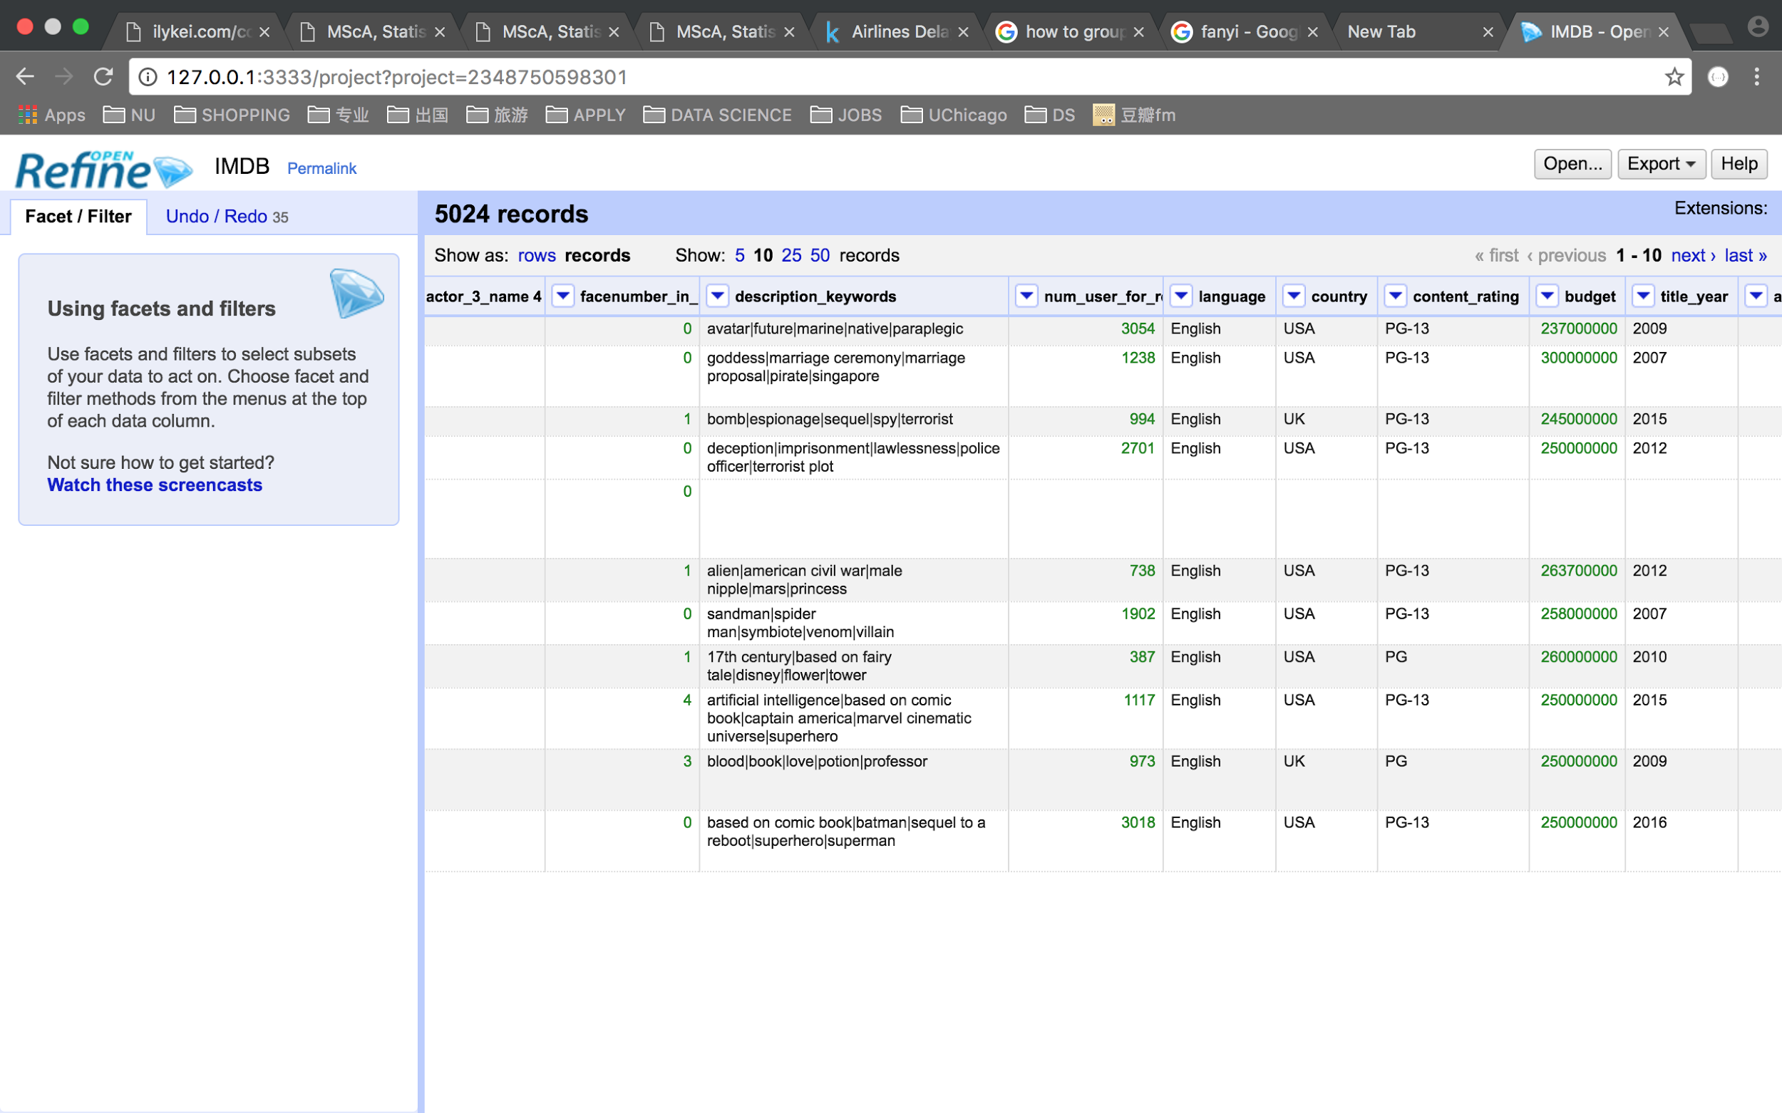

Data cleaning – OpenRefine
Data Cleaning
5

Slide 7
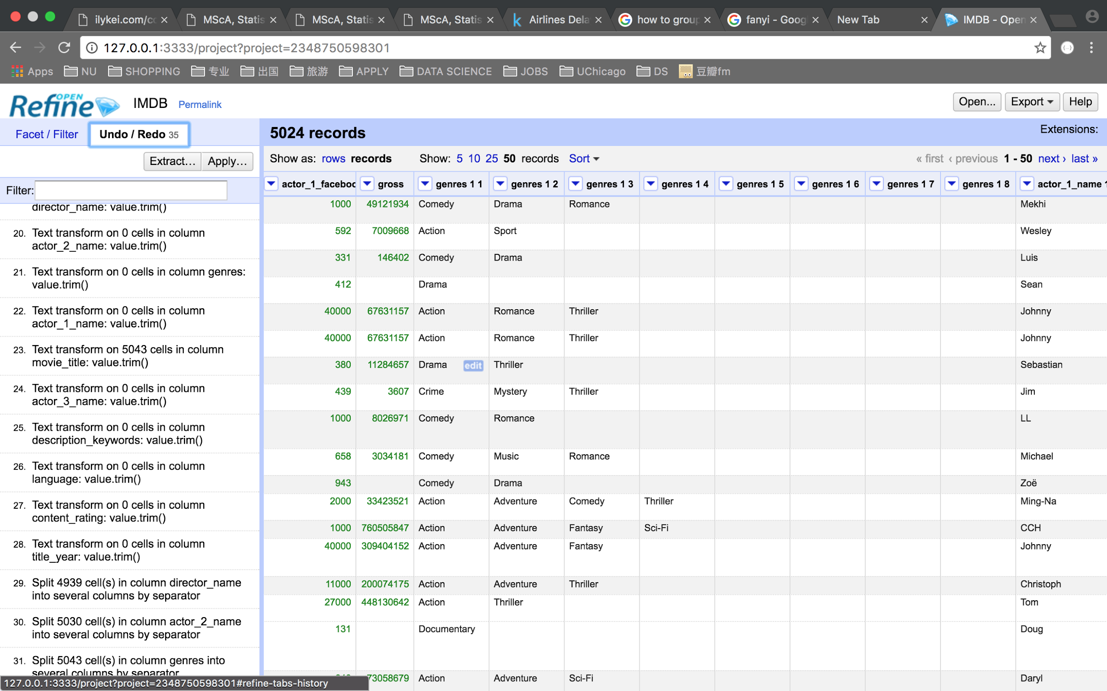
Data cleaning – OpenRefine
Data Cleaning
6

Slide 8
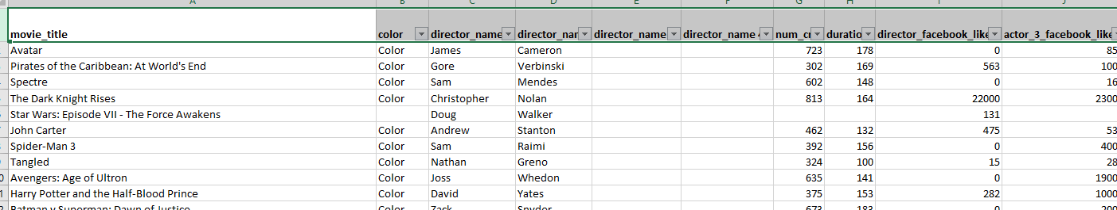
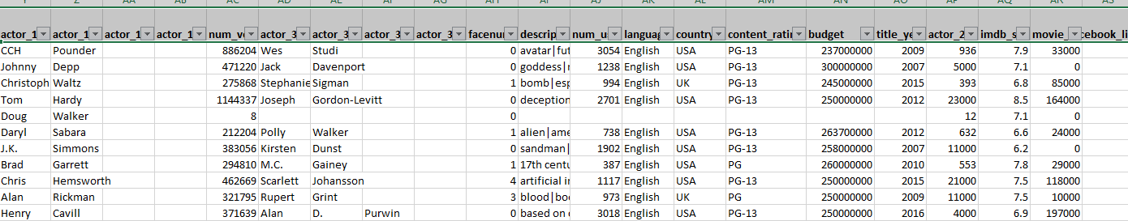
Normalization Tools: OpenRefine and Excel
Normalization
7

Slide 9
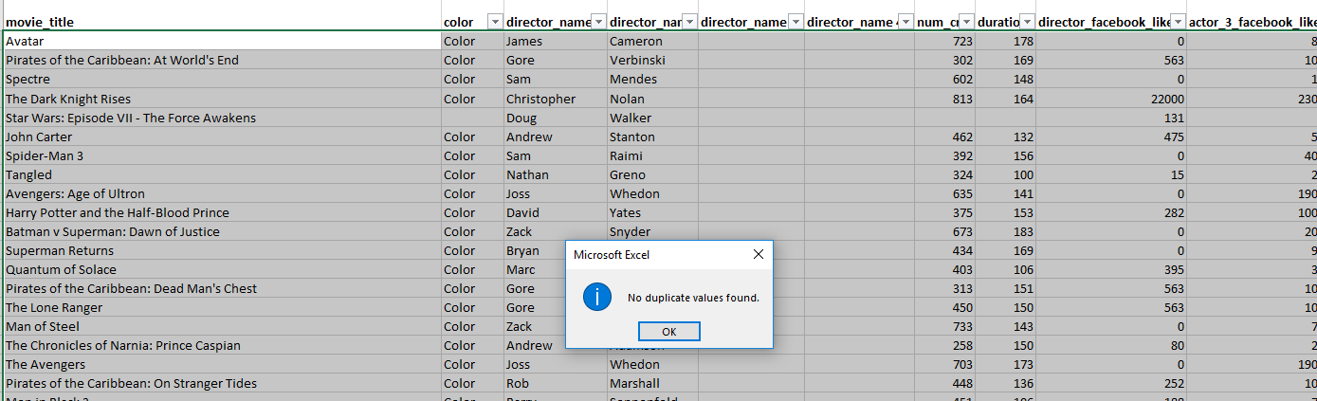
Normalization 1st Normal Form
Normalization
Excel: Data – Remove Duplicates
OpenRefine – Separate Names for Directors and Actors, and Genre
8

Slide 10
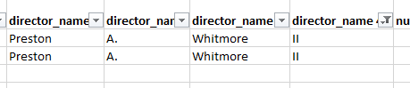
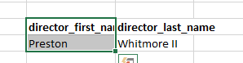
Normalization
Normalization 1st Normal Form
Excel – Keep two columns of names for Directors and Actors
Before: Four columns for the name information
After: Two columns for the name information
9

Slide 11
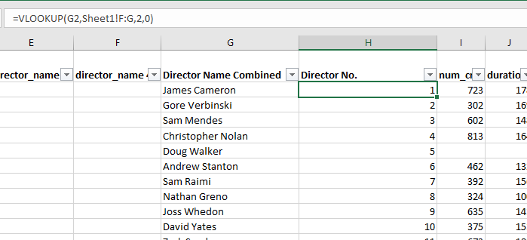
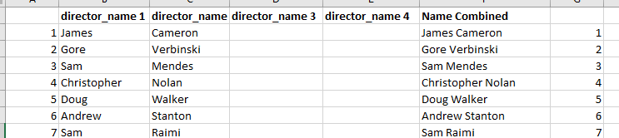
Normalization
Normalization 2nd Normal Form
Excel Vlookup to create FK
Director Table
Film Table
10

Slide 12
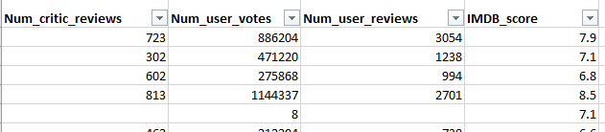
Normalization
Normalization
Film Table
11

Slide 13
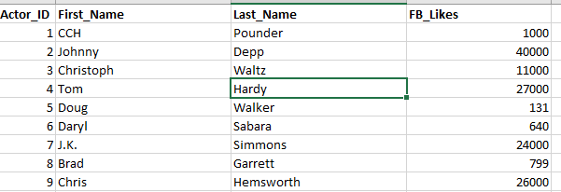
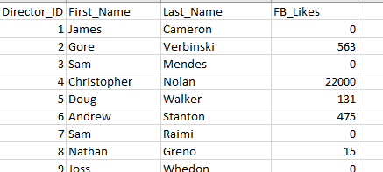
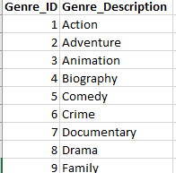
Normalization
Normalization
Actor Table
Director Table
6,385 records
Genre Table
2,402 records
26 records
12

Slide 14
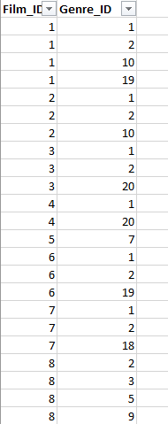
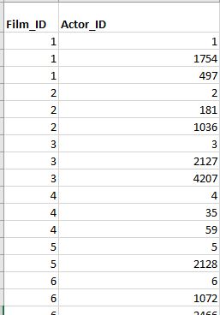
Normalization
Normalization – Joint Tables
Film_Genre Table
Film_Actor Table
14,505 records
15,087 records
13

Slide 15
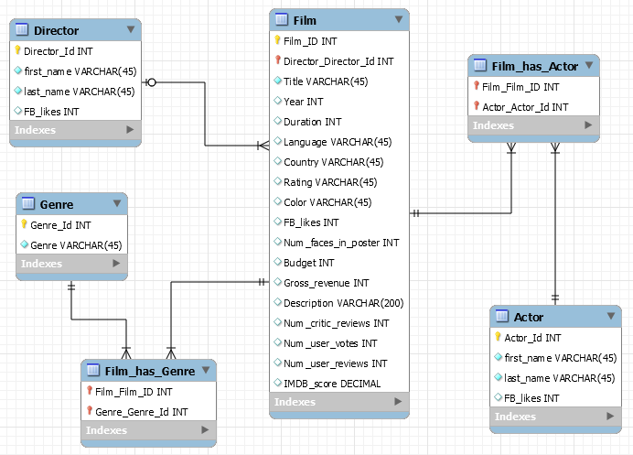
ERD
ERD
14

Slide 16
ERD
ERD
Entity1: Film
Entity2: Director
Entity3: Actor
Entity4: Genre
Film_id (PK) – INT Director_id (FK) – INT | Director_id (PK) – INT | Actor_id (PK) – INT | Genre_id (PK) – INT
Title – varchar(45) Year – INT Duration – INT | First_name – varchar(45) Last_name – varchar(45) | First_name – varchar(45) Last_name – varchar(45) | Genre – varchar(45)
Language – varchar(45) Country – varchar(45) Rating – varchar(45) | FB_likes – INT | FB_likes – INT
Color – varchar(45) FB_likes – INT Num_faces_in_poster – INT
Budget – INT Gross_revenue – INT Description – varchar(200)
Num_critic_reviews – INT Num_user_votes – INT Num_user_reviews – INT IMDB_score – Decimal
15

Slide 17
Data Loading
Data Loading
Mind the Constraints
16

Slide 18
Data Loading
Data Loading
Drop the
FK
17

Slide 19
Sample business questions
Data Analysis
Which 10 directors have top grossing movies?
Which 10 directors have the most FB likes?
Which 10 actors are most profitable?
Which country has the top grossing movies till date?
Which 15 films have most facebook likes?
Which 10 movies have the highest IMDB scores and highest gross revenue?
Which genre has the highest number of votes?
Which actor’s movies have received the most critic-reviews?
18

Slide 20
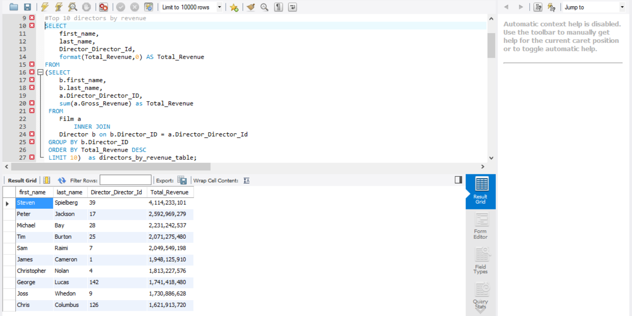
Data Analysis
Which 10 directors have the top grossing movies? - Create a query that links two different tables and use subquery to get the results in desired format.
Data Analysis
19

Slide 21
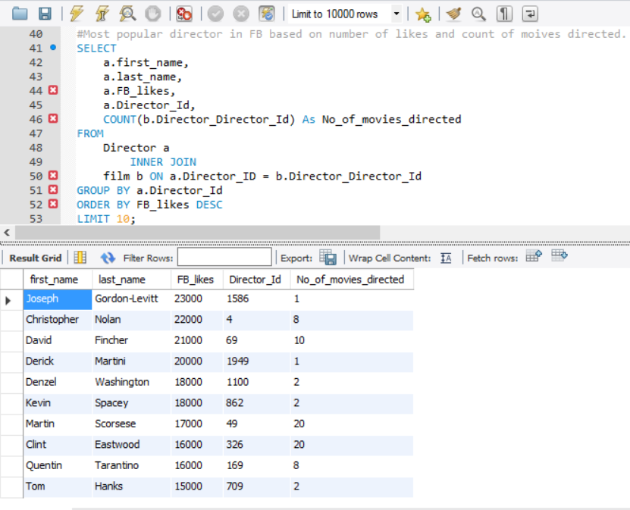
Data Analysis
Which 10 directors have most Facebook likes? - Create a query that links two different tables.
Data Analysis
20

Slide 22
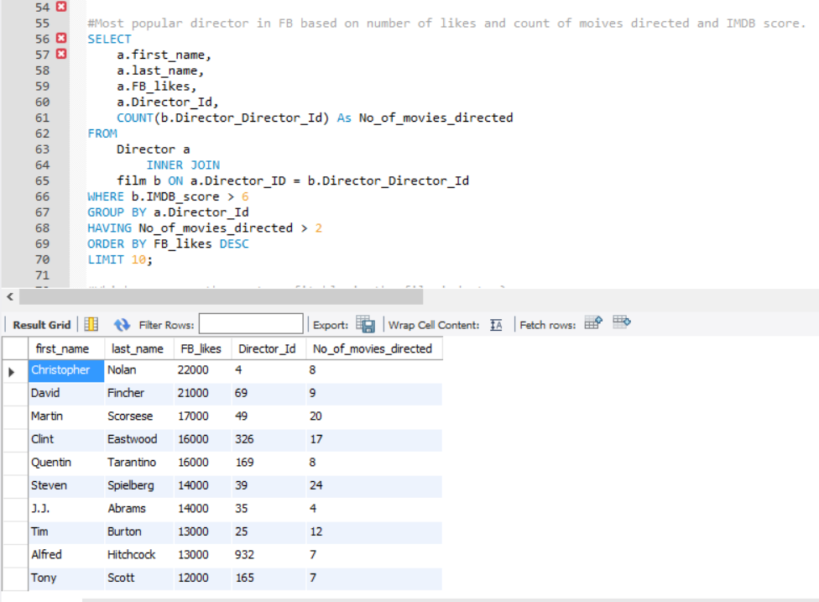
Data Analysis
Which 10 directors have most Facebook likes? - Create a query that links two different tables, uses WHERE, GROUP BY and HAVING clauses
Data Analysis
21

Slide 23
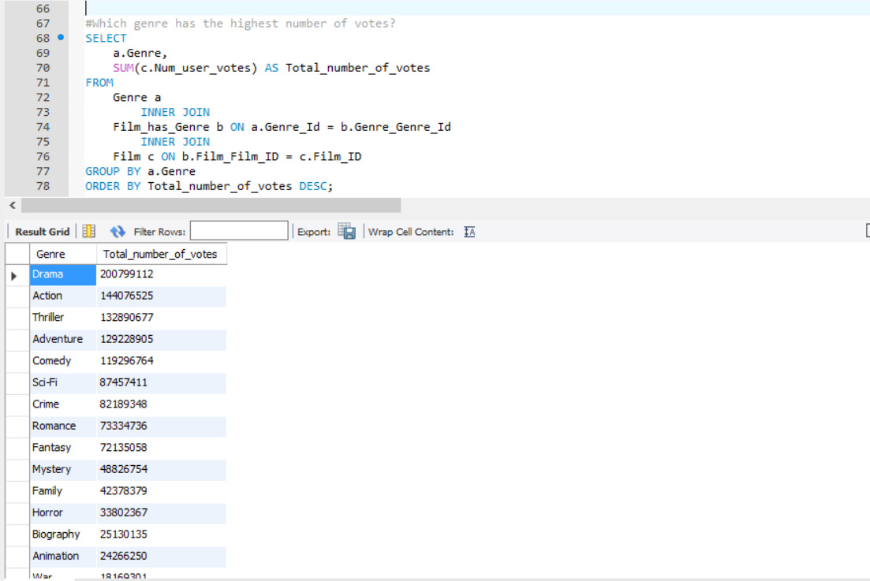
Data Analysis
Which genre has received highest number of votes? - Create a query that links three different tables.
Data Analysis
22

Slide 24
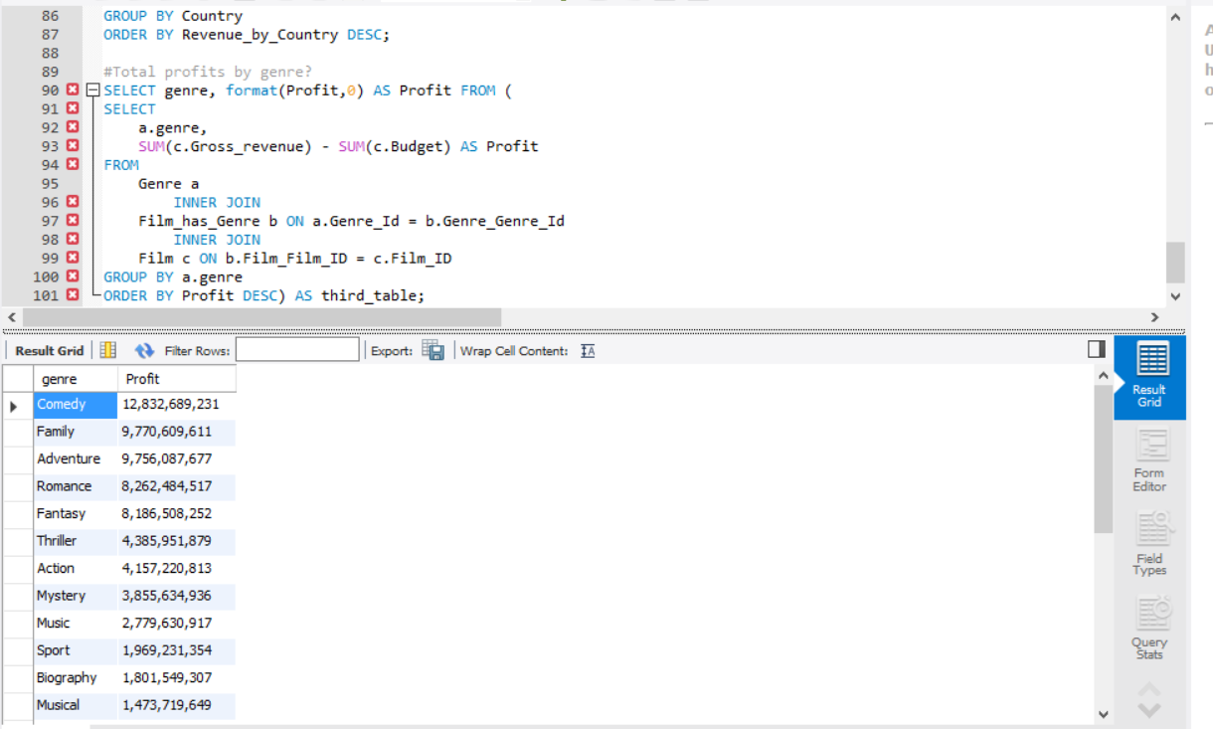
Data Analysis
Analyze profit by genres? - Create a query that links three different tables and uses sum functions to find difference between two columns.
Data Analysis
23

Slide 25
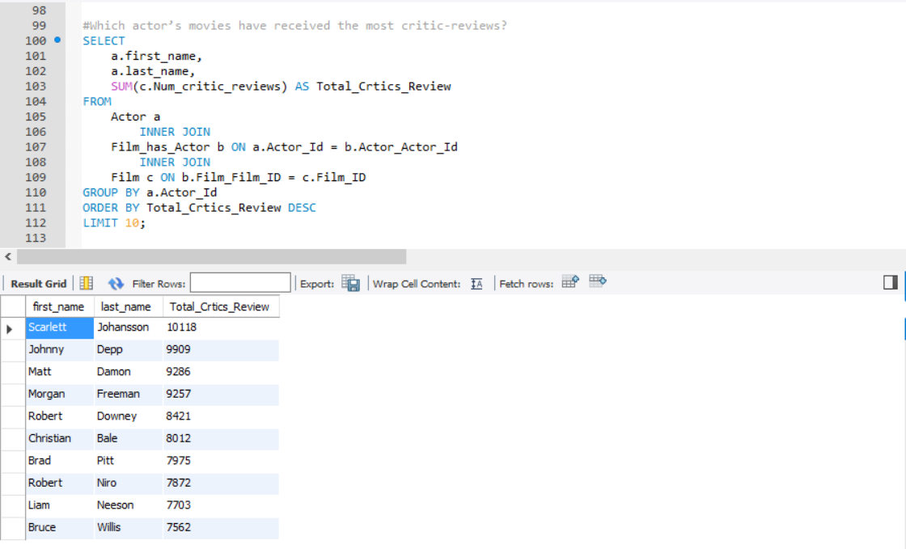
Data Analysis
Which actor’s movies have received the most critic-reviews? - Create a query that links three different tables and uses aggregation.
Data Analysis
24

Slide 26
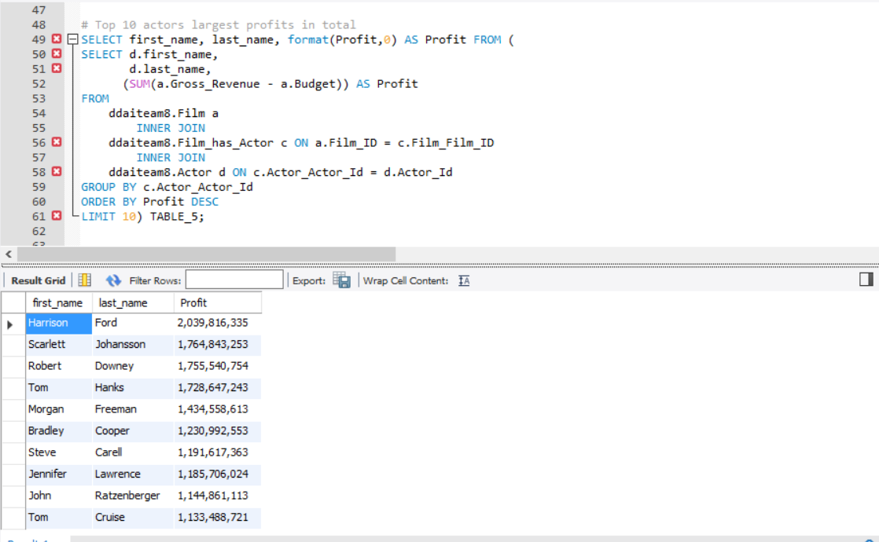
Data Analysis
Which actor’s are most profitable? - Create a query that links three different tables and uses aggregation and format via sub-query.
Data Analysis
25

Slide 27
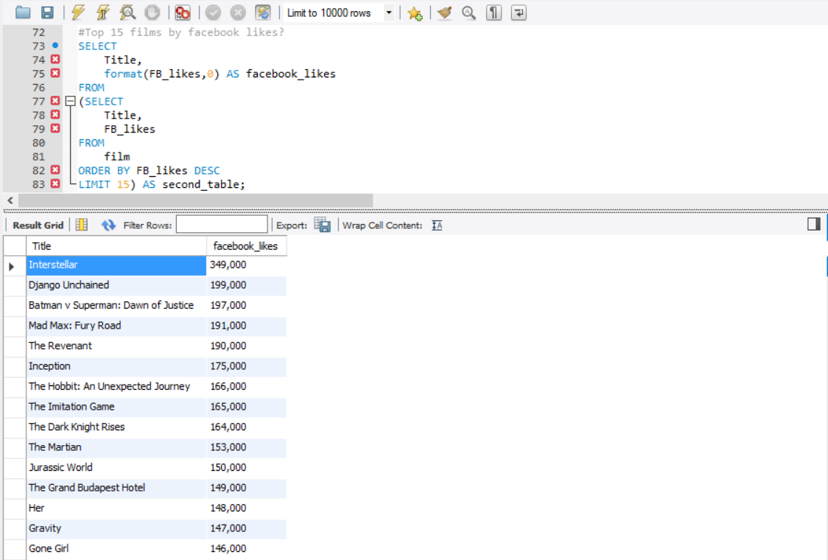
Data Analysis
Which are the top 15 films by facebook likes? - Create a query that extracts data from a table and use sub-query for format.
Data Analysis
26

Slide 28
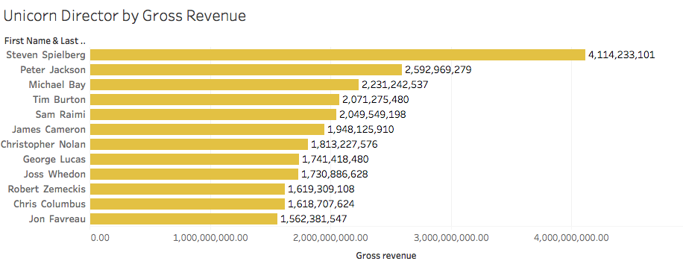
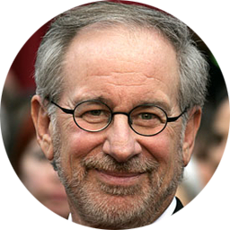
Unicorn directors by gross revenue
Visualization
27

Slide 29
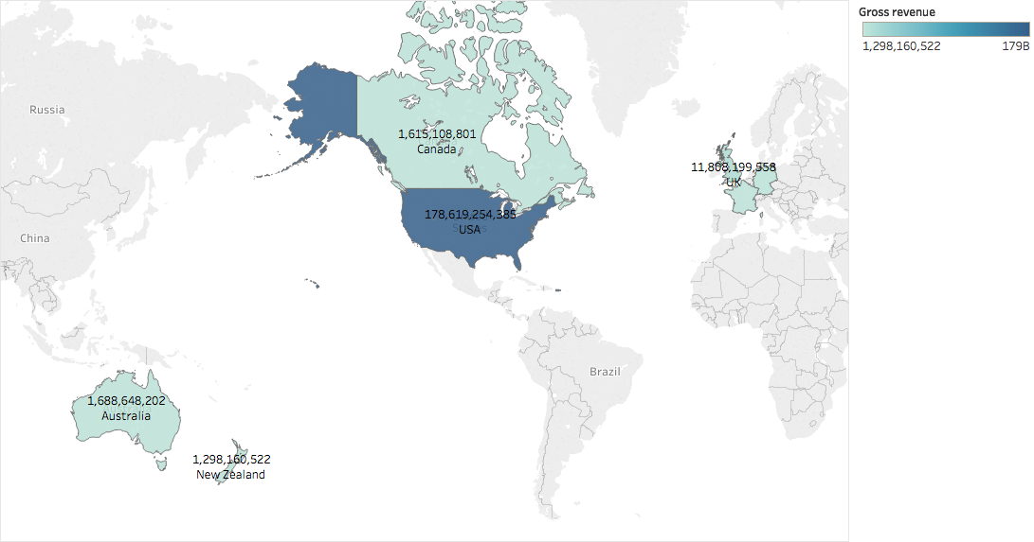
Top film revenue by country
Visualization
28
Notes:
US is the only country has film revenue more than 100B.

Slide 30
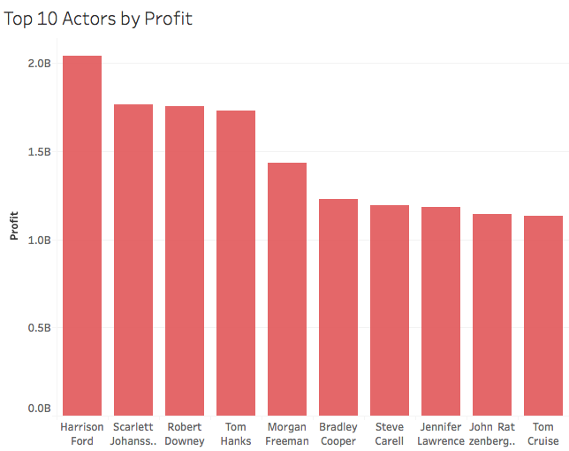


Top 10 actors by profit
Visualization
29

Slide 31
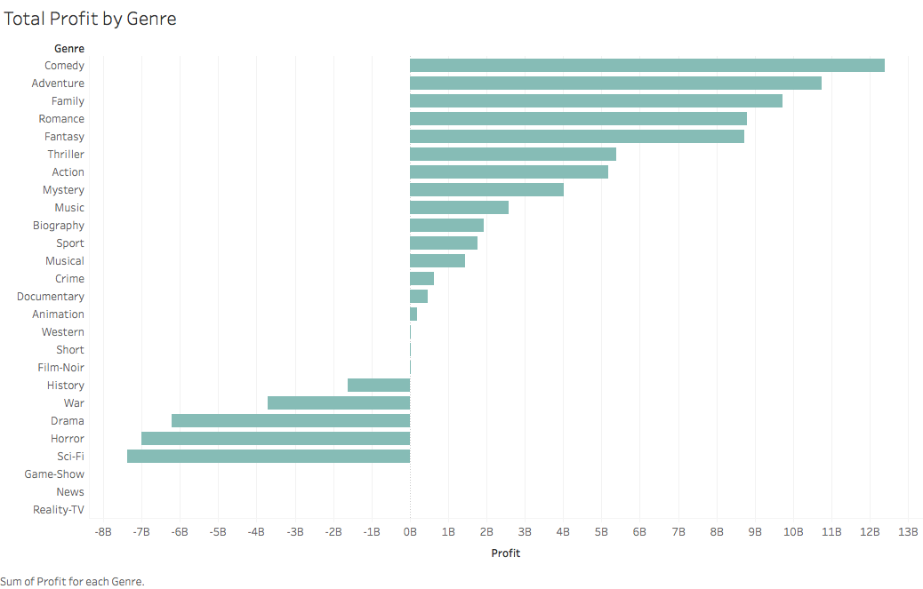
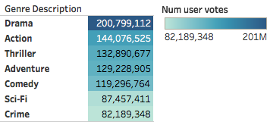
Total profit by genre vs genre votes
Visualization
30

Slide 32
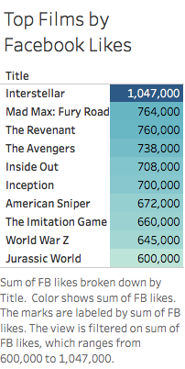
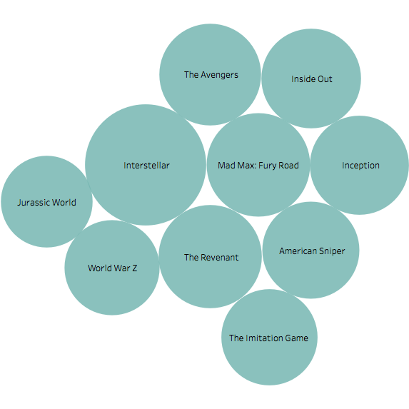

Top films by Facebook likes
Visualization
31

Slide 33
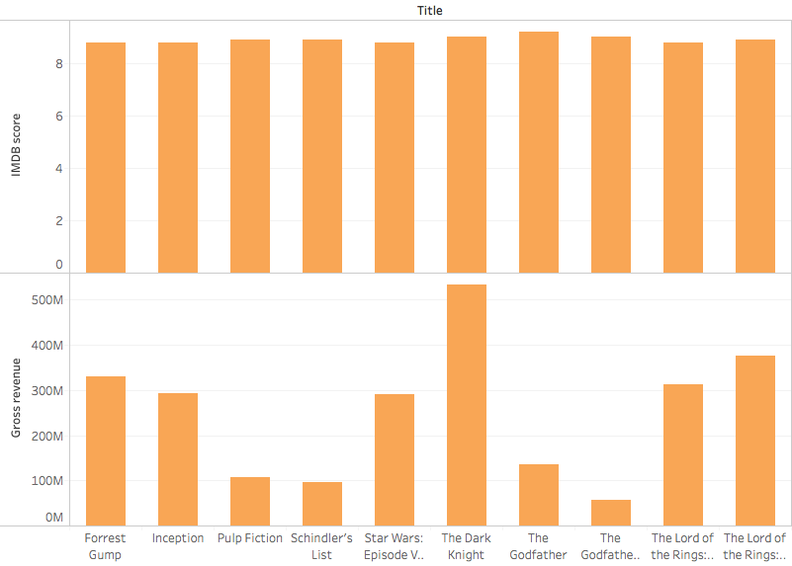

Movies having highest IMDB scores and highest gross revenue
Visualization
32

Slide 34
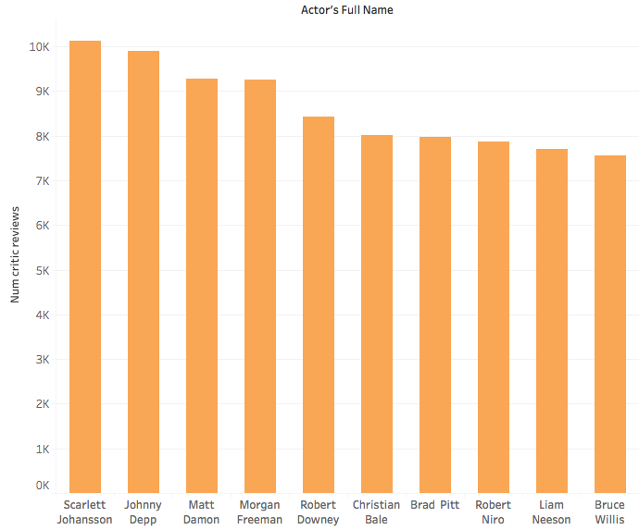

Actors whose films have most critic reviews
Visualization
33

Slide 35

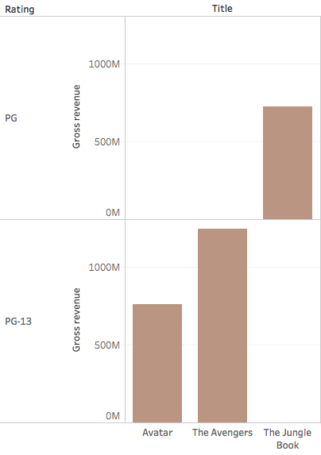


Top-3 movie ratings by gross revenue
Visualization
34

Slide 36
Lessons Learned
Summary
Data Exploration
Data Cleaning
Normalization
EER Diagram
Complex SQL queries with multiple joins, calculations, formatting, etc.
Database Schema
Visualization - Tableau
35

Slide 37

Thank You
36

